Slide 1
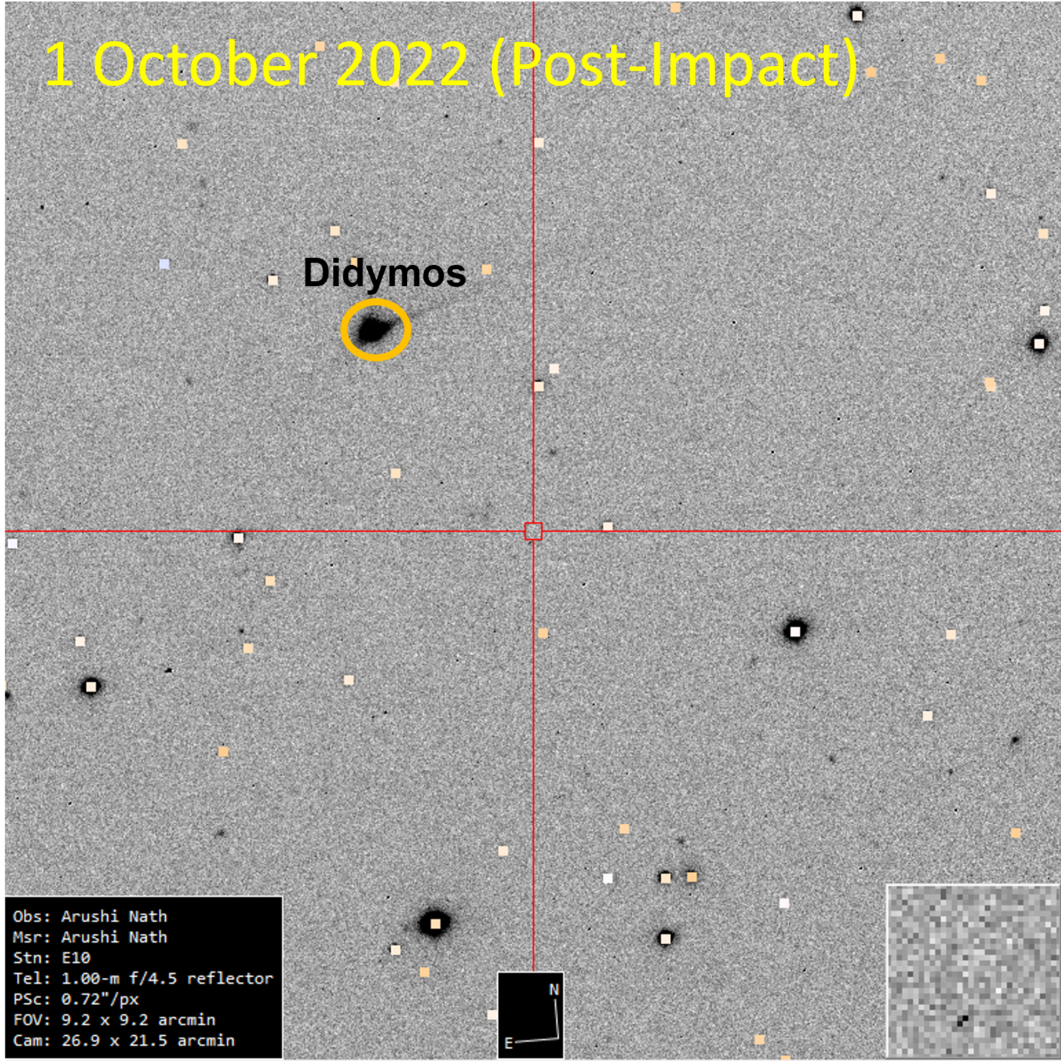
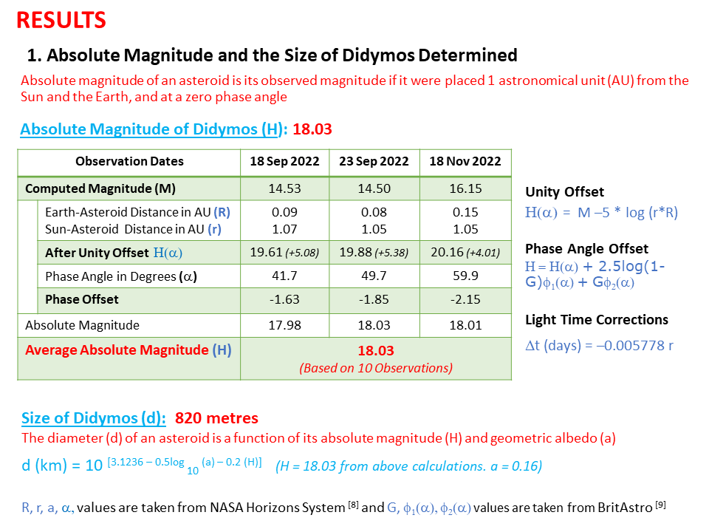
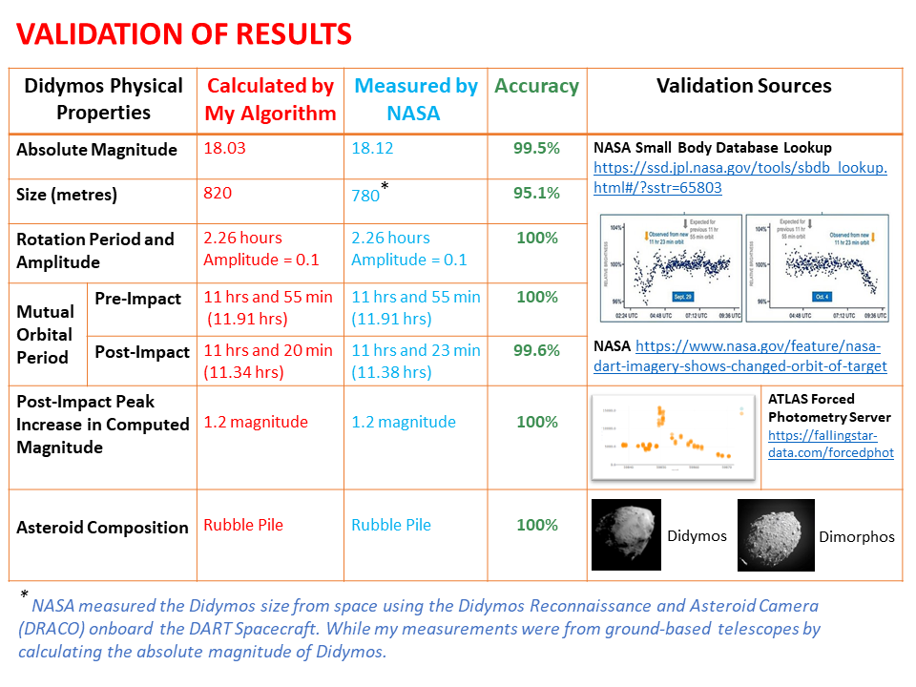
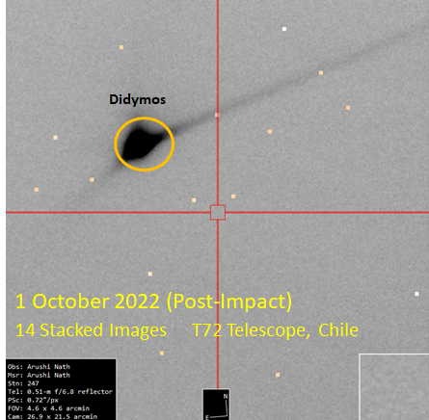
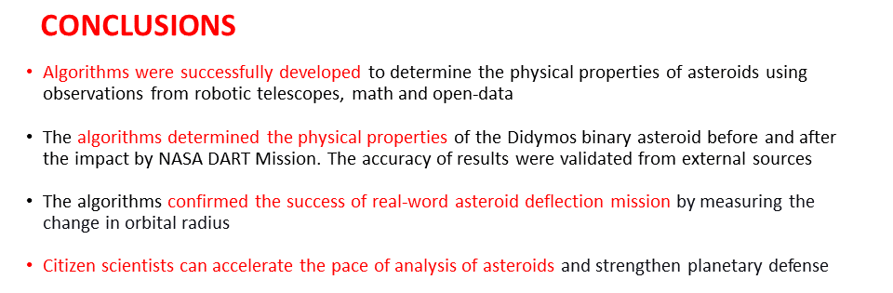
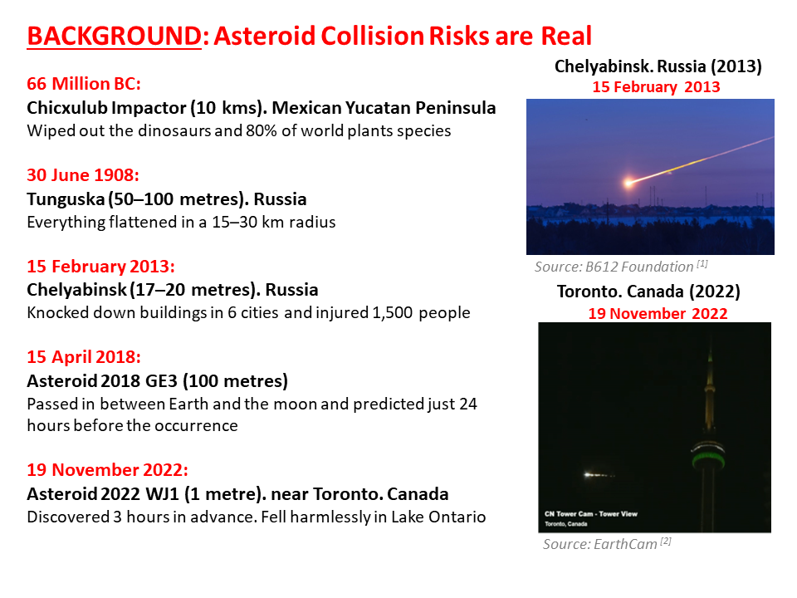
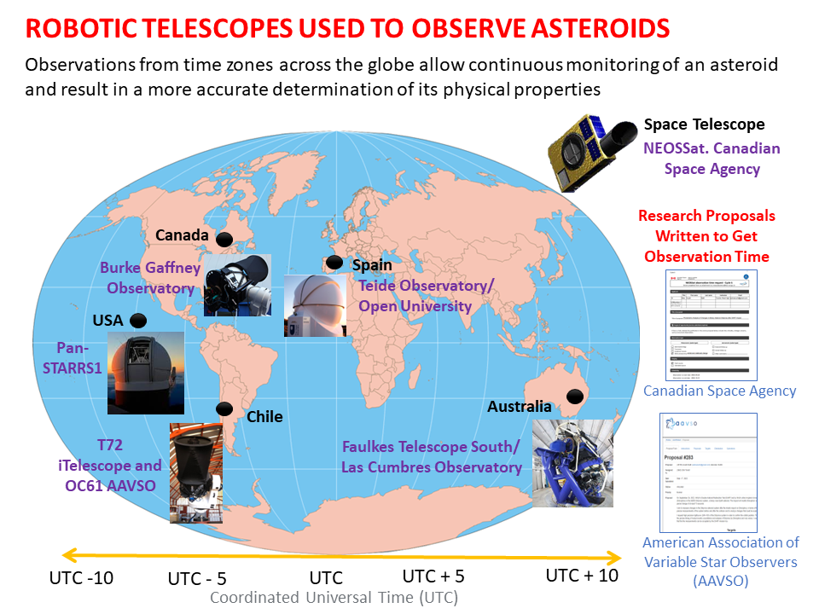
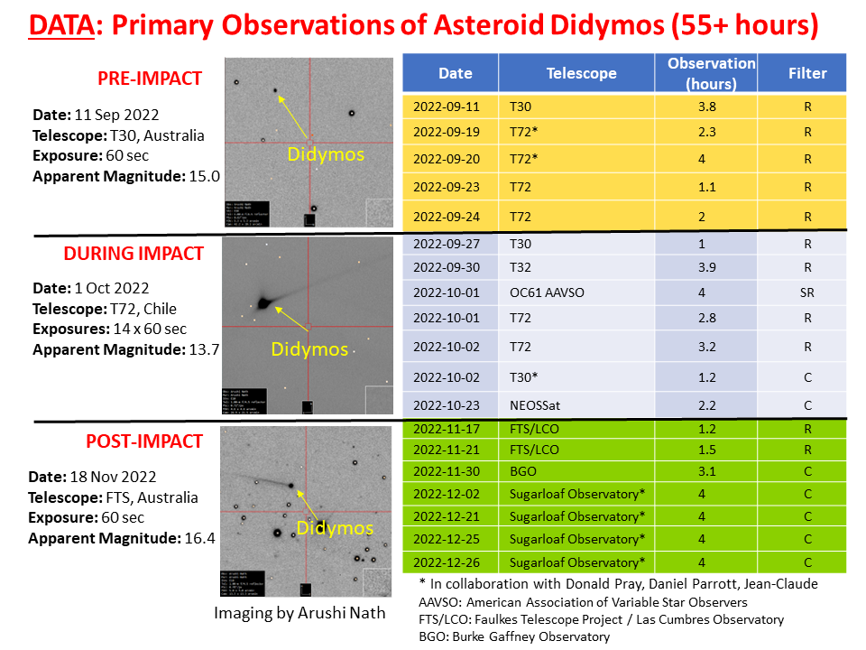
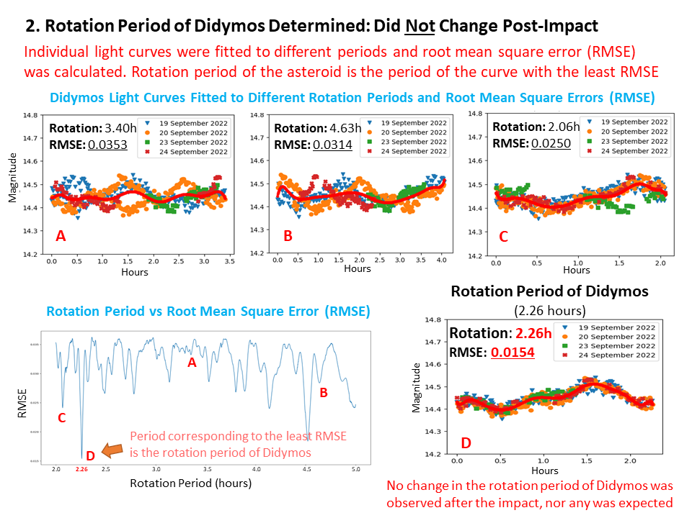
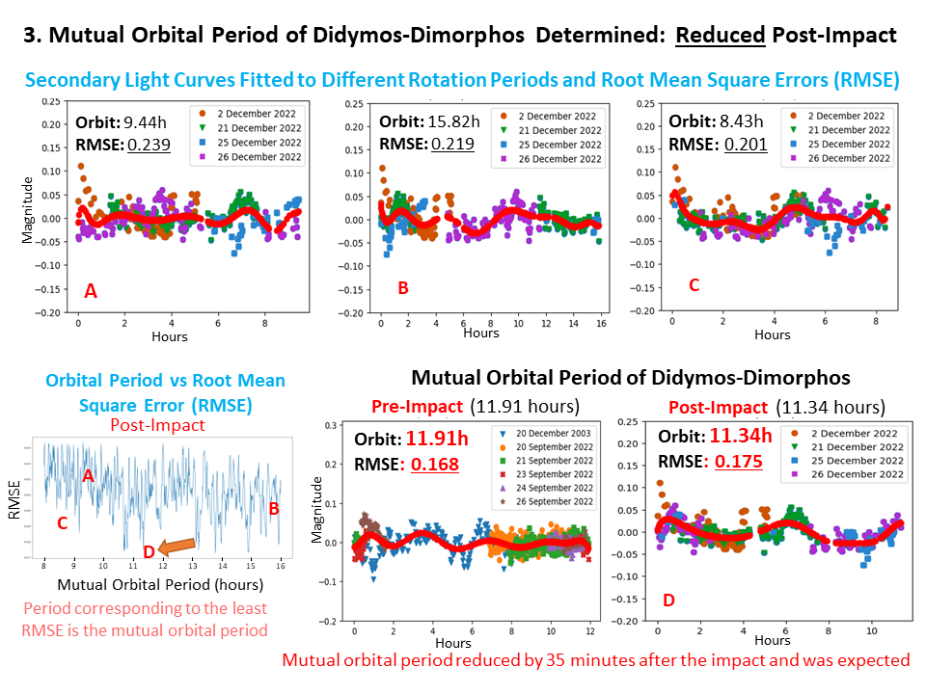
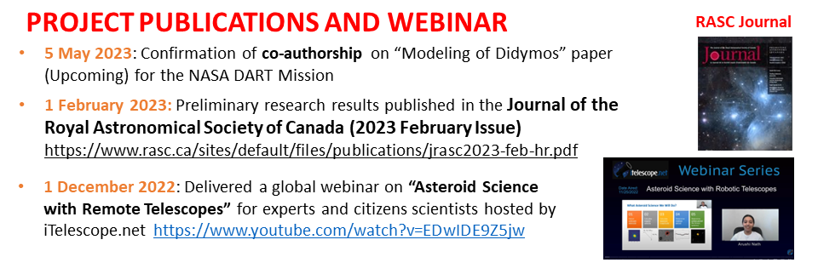
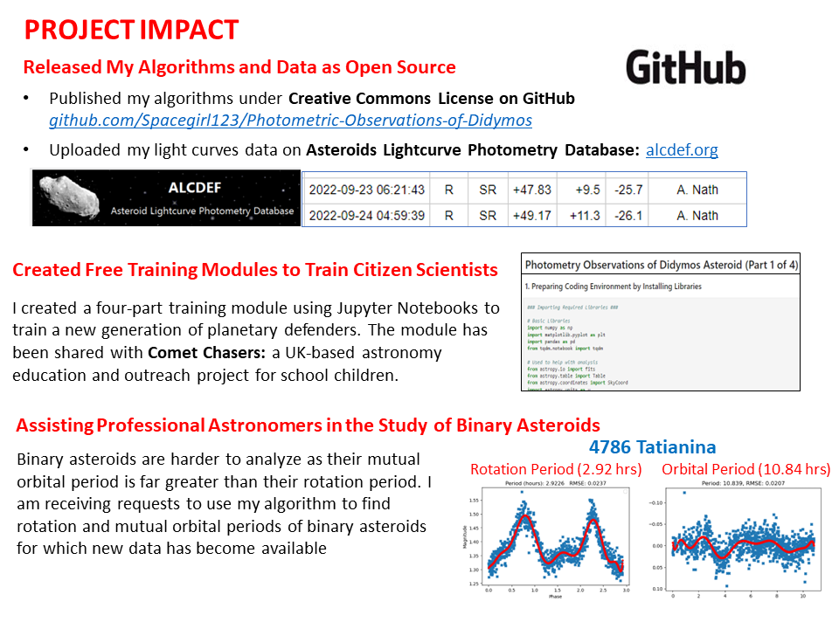
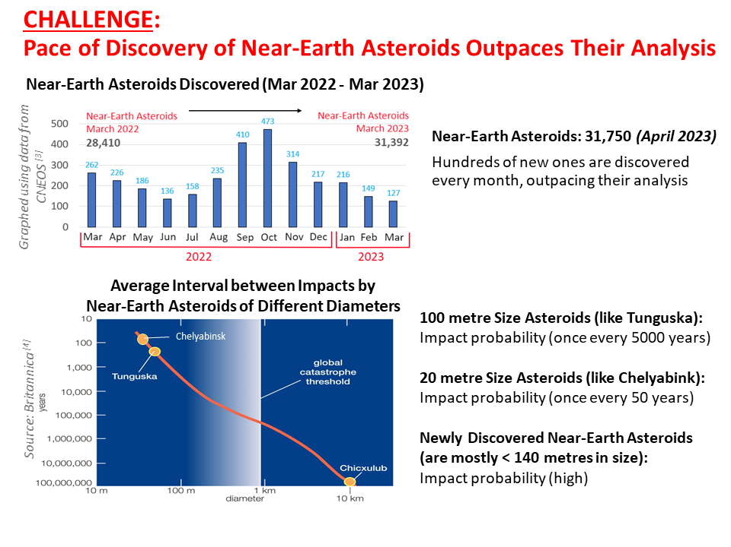
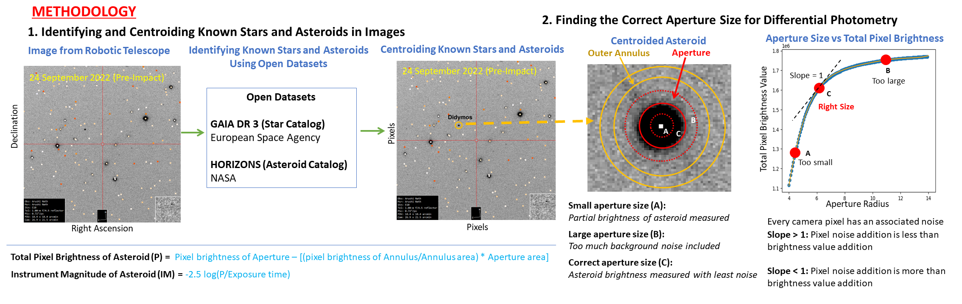
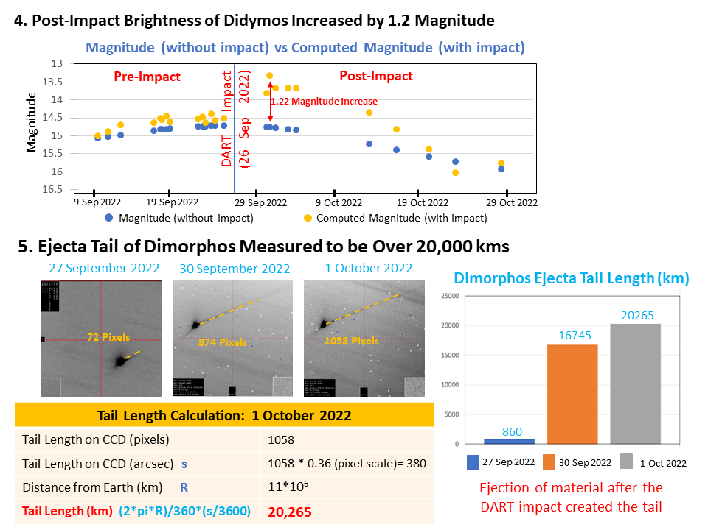
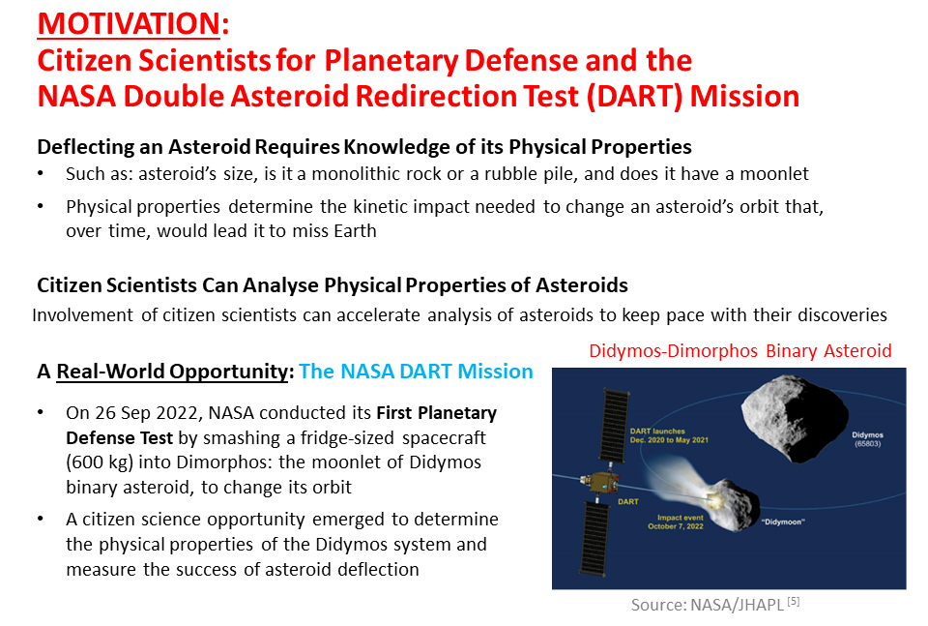
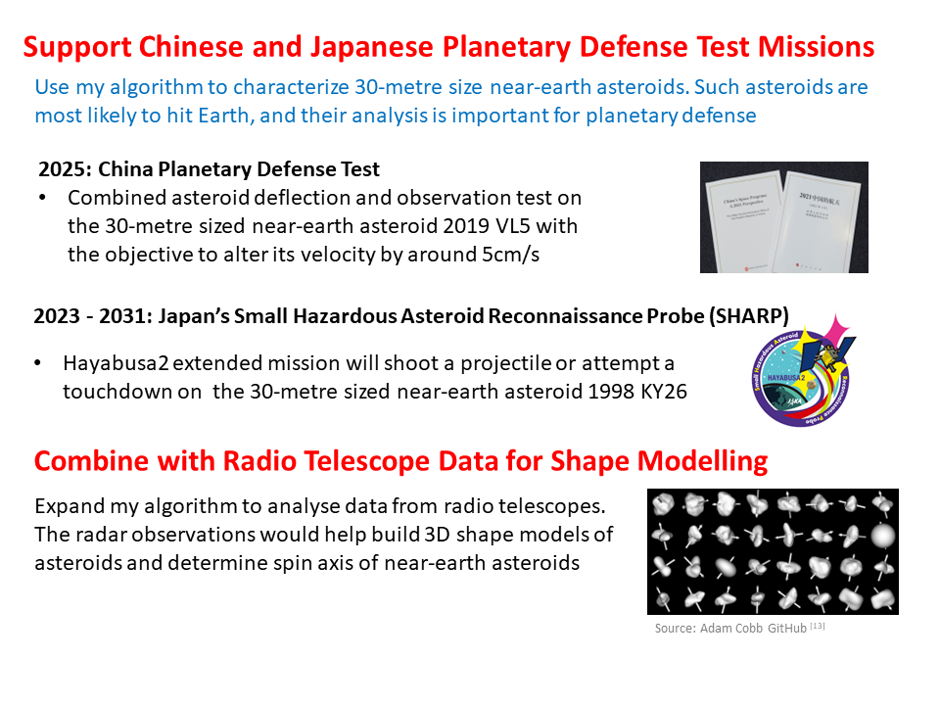
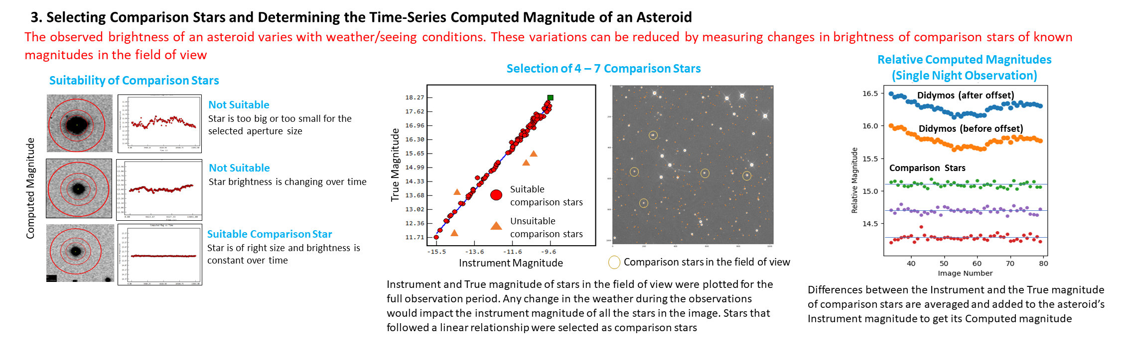
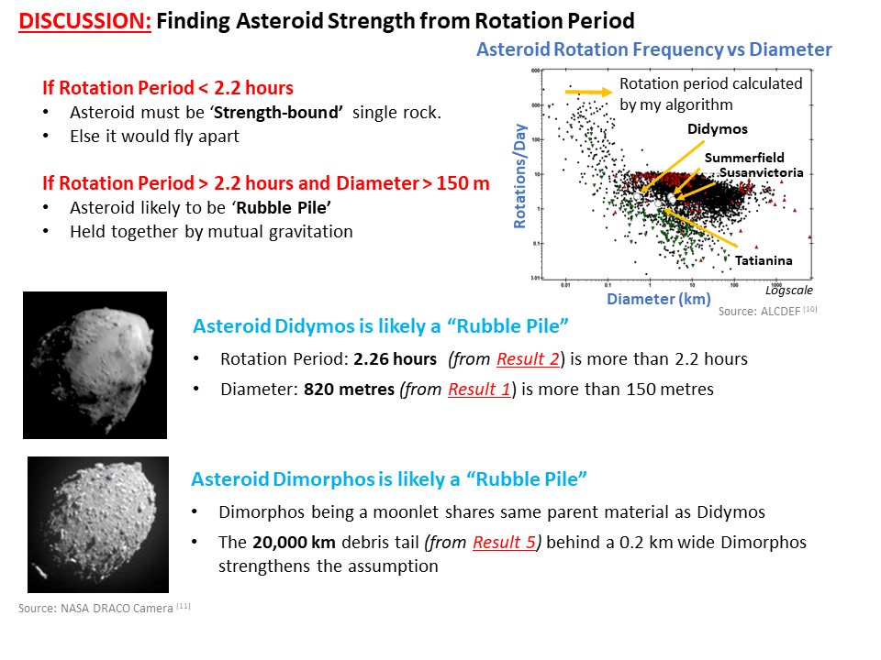
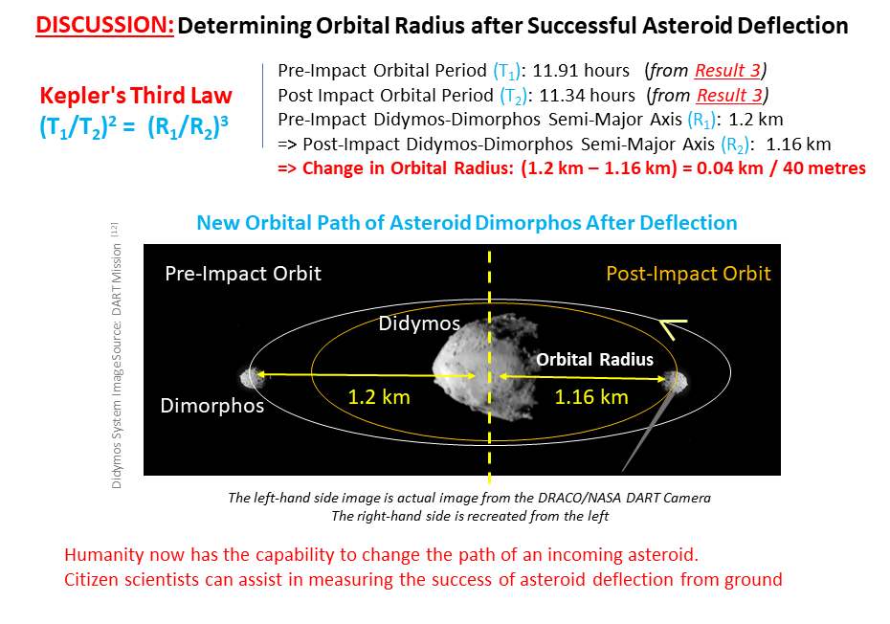
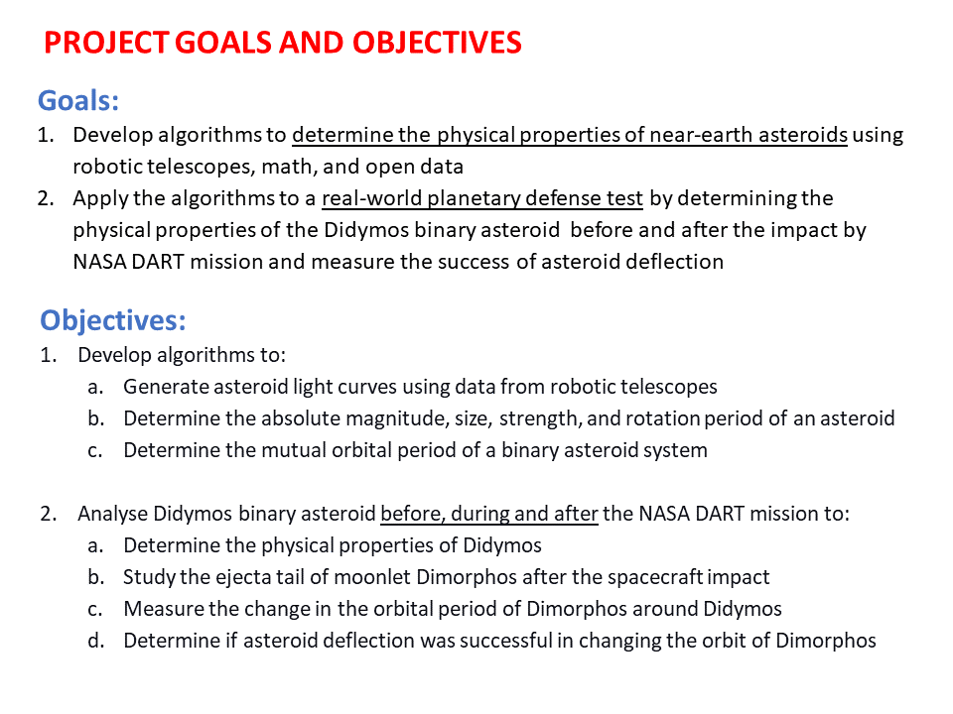
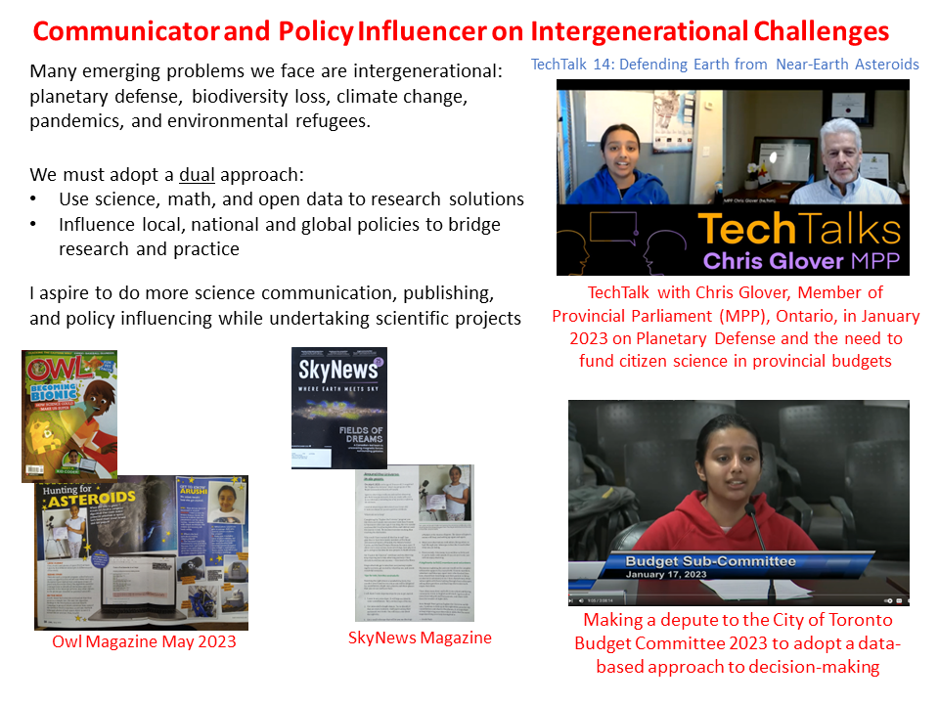
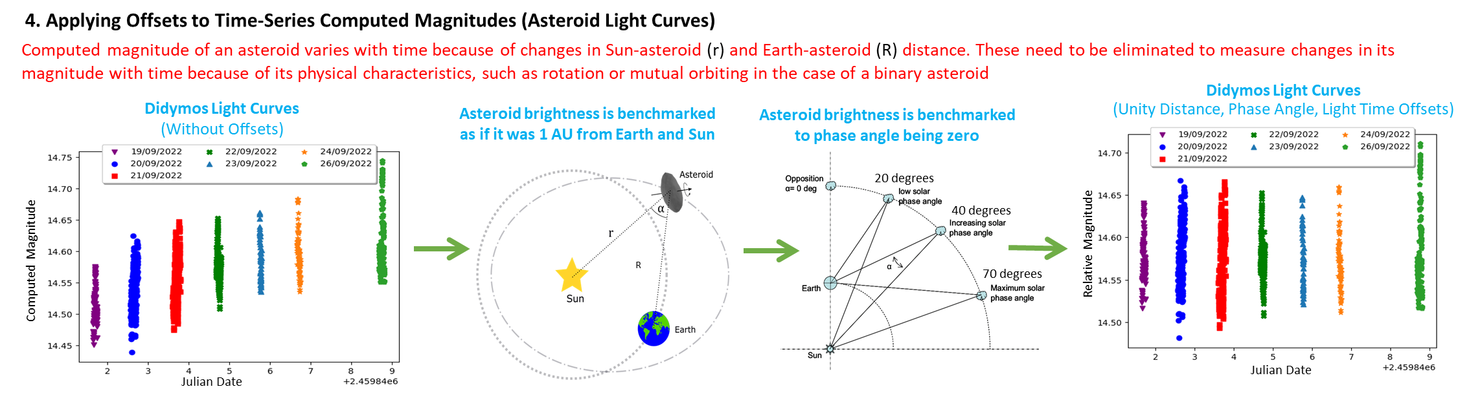
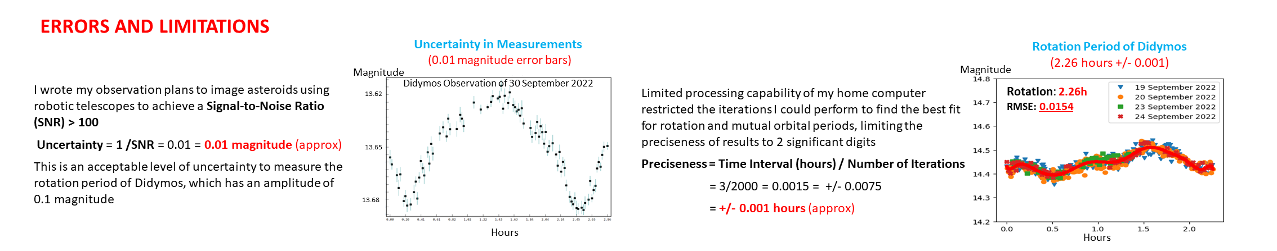
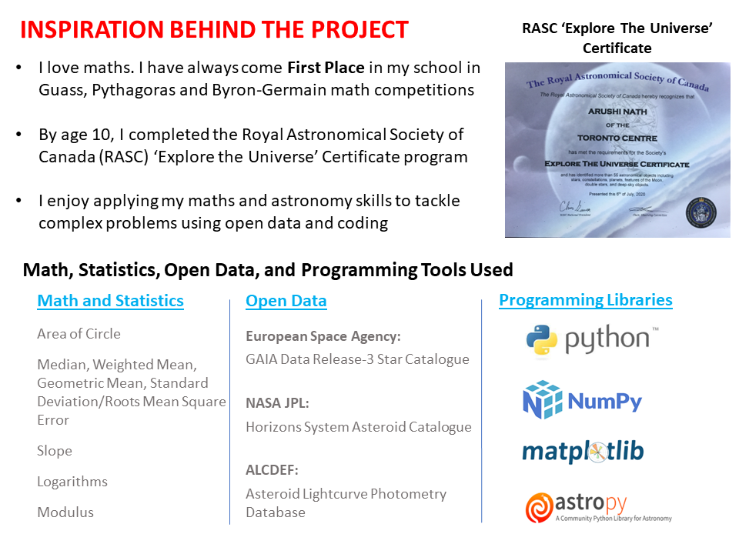
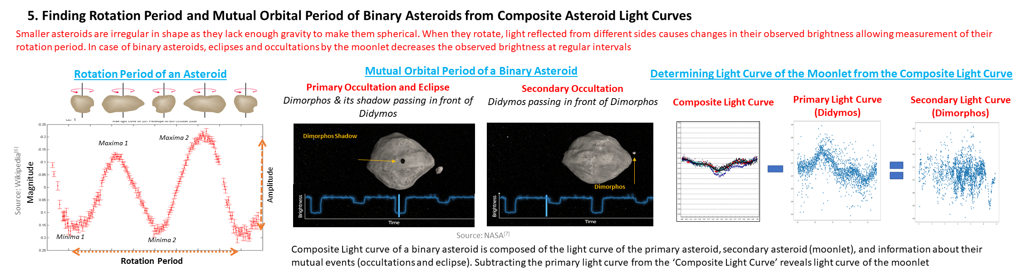
This "dot" is a Near-Earth Asteroid!
My Algorithm can Determine its Size, Strength, Rotation and
Mutual Orbital Period
v
What?
Why?
How?
How?
How did you perform your experiment or develop your solution?
300 words (including this How section and the one on the other side), plus images
What’s Next?
So What?
Magnitude
13.62
13.65
13.68
Hours
Acknowledgements
(Alphabetic Order)
References
Brian D. Warner (ALCDEF): For providing the most recent version of the asteroid lightcurve database (LCDB)
Christian Sasse, Leigh Moore and Mladen Dugec (iTelescope): Supporting my telescope observation runs and technical assistance
Cristina Tomas (NASA): Project Lead, Observations Working Group for NASA DART Mission for advice over zoom calls on the project
Daniel Parrot (Tycho Software): Providing technical inputs and coordinating on Didymos observations
Donald Prey (Sugarloaf Mountain Observatory): For sharing post-impact observations of Didymos
Helen Usher and Sarah Roberts (Faulkes Telescope): For telescope time with Faulkes Telescope South and advice
Jean-Claude Merlin (France): For sharing observations of Didymos ejecta
Kenneth Menzies and Dirk Terrell (AAVSO): For supporting my proposal and providing data from the OC61 telescope
Martin Bergeron and Denis Laurin (Canadian Space Agency): For supporting my NEOSSat observation proposal and providing data
Paul Roche (Cardiff University, UK): For advice on project outreach to youths and schools
[1] B612 Foundation. Nine-year anniversary of the Chelyabinsk asteroid blast [Photograph]. https://b612foundation.org/nine-year-anniversary-of-the-chelyabinsk-asteroid-blast/
[2] EarthCam. (2022, November 21). CN Tower Meteor [Video]. YouTube. https://www.youtube.com/watch?v=ARpFSANDopQ
[3] Center for Near-Earth Object Studies. Total number of asteroids discovered monthly. Retrieved from https://cneos.jpl.nasa.gov/stats/totals.html
[4] Encyclopædia Britannica. Earth impact hazard: Frequency of impacts [Photograph]. https://www.britannica.com/science/Earth-impact-hazard/Frequency-of-impacts
[5] NASA/Johns Hopkins University Applied Physics Laboratory. (2022, March 7). NASA's first planetary defense technology demonstration to collide with asteroid in 2022 [Photograph]. https://www.nasa.gov/feature/nasa-s-first-planetary-defense-technology-demonstration-to-collide-with-asteroid-in-2022
[6] Wikipedia. (2022, April 5). Light curve [Photograph]. https://en.wikipedia.org/wiki/Light_curve
[7] NASA. DART mission status. https://az659834.vo.msecnd.net/eventsairwesteuprod/production-atpi-public/6fbb31040935429f90cbb68736b66bdb
[8] NASA Jet Propulsion Laboratory. Horizons system. https://ssd.jpl.nasa.gov/horizons/app.html#/
[9] Gault, D. Lightcurves of minor planets. British Astronomical Association. https://britastro.org/asteroids/dymock4.pdf
[10] Association of Lunar and Planetary Observers. About light curves [Photograph]. https://alcdef.org/php/alcdef_aboutLightcurves.html
[11] NASA DRACO Camera [Photograph]. https://www.nasa.gov/feature/dart-s-final-images-prior-to-impact
[12] NASA. DART’s final images prior to impact [Photograph]. https://www.nasa.gov/feature/dart-s-final-images-prior-to-impact
[13] Addam Cobb GitHub. 3D Shape Modelling of Asteroids [Photograph]. https://adamcobb.github.io/journal/3D-Shape-Modelling-of-Asteroids.html

